Slide 1
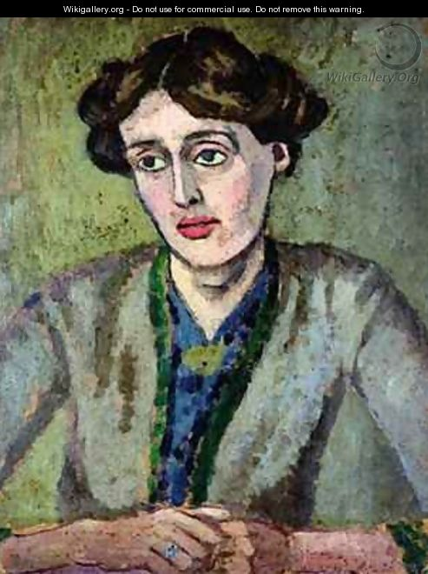


Virginia Woolfs Essays
Vortrag auf der Tagung
„Essayistik der Moderne“
Kiel, 8.-11. Mai 2013

Slide 2

Einleitung
A Room of One’s Own (1929)
“With money and leisure at their service, women will naturally occupy themselves more than has hitherto been possible with the crafts of letters […]. From this it is a short step to the practice of the sophisticated arts, hitherto so little practised by women – to the writing of essays and criticism, of history and biography.”

Slide 3
Gliederung
Einleitung: “A woman must have money and a room of her own
if she is to write fiction”
I. Woolfs essayistisches Schaffen: “the most accomplished and innovative
essayist of her generation“
II. Woolfs Theorie des Essays: „about God or Spinoza, or about turtles
and Cheapside“
III. Der freie Essay – Zwei Beispiele
Street Haunting: A London Adventure: Von der Notwendigkeit,
einen Bleistift zu kaufen
Evening over Sussex: Zwiegespräche im Abendlicht
Zusammenfassung: Der Essay als androgyne Form?

Slide 4
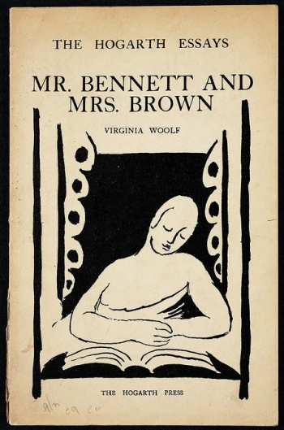


I. Woolfs essayistisches Schaffen:
“the most accomplished and innovative essayist of her generation“
1. Literaturkritische Essays
2. Poetologische Essays
3. Biographische Essays
4. Feministische Essays
5. Freie Essays
“There is no room for the impurities
of literature in an essay“

Slide 5
II. Woolfs Theorie des Essays:
„about God or Spinoza, or about turtles and Cheapside“
The Modern Essay (1922)
„It should lay us under a spell with its first word, and we should only awake, refreshed, with its last. In the interval we may pass through the most various experiences of amusement, surprise, interest, indignation. We may soar to the heights of wisdom with Lamb or plunge to the depths of wisdom with Bacon, but we must never be roused”.
„The art of writing has for backbone some fierce attachment to an idea. It is on the back of an idea, something believed in with conviction or seen with precision and thus compelling words to its shape”
„Vague as all the definitions are, a good essay must have this permanent quality about it; it must draw its curtain round us, but it must be a curtain that shuts us in, not out.”

Slide 6
II. Woolfs Theorie des Essays:
„about God or Spinoza, or about turtles and Cheapside“
Women and Fiction (1929)
„For very little ist known about women. The history of England is the history of the male line, not the female”.
„And living as she did in the common sitting-room, surrounded by people, a woman was trained to use her mind in observation und upon the analysis of character. She was trained to be a novelist and not to be a poet”
„It is a sentence by a man; it is to loose, to heavy, to pompous for a woman’s use“.
„She will find that she is perpetually wishing to alter the established values – to make serious what appears insignificant to a man, and trivial what is to him important“.

Slide 7
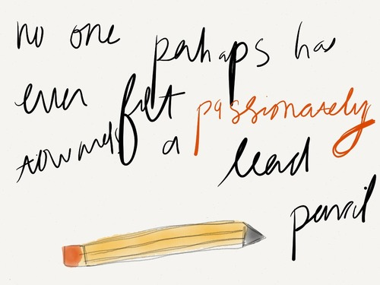
III. Der freie Essay – Zwei Beispiele
Street Haunting: A London Adventure (1927)
„For there we sit surrounded by objects which perpetually express the oddity of our own temperaments and enforce the memories of our own experience“
„Where we may ask, as we raise our left foot obediently upon the stand, ‚What, then, is it like to be a dwarf?‘“
„Indeed, the dwarf had started a hobbling grotesque dance to which everybody in the street now conformed“
„Let us choose those pearls, for example, and then imagine how, if we put them on, life would be changed“

Slide 8
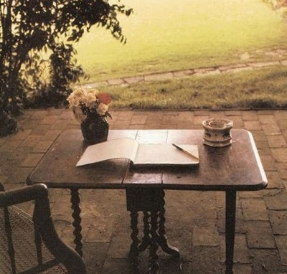
III. Der freie Essay – Zwei Beispiele
“Yet it is nature’s folly, not ours. When she set about her chief masterpiece, the making of man, she should have thought of one thing only. […] Am I here, or am I there? Or is the true self neither this nor that, neither here nor there, but something so varied and wandering that it is only when we give the rein to its wishes […]. Circumstances compel unity; for convenience’s sake a man must be a whole. The good citizen when he opens the door in the evening must be banker, golfer, husband, father; not a nomad wandering the desert, a mystic staring at the sky […]. When he opens his door, he must run his fingers through his hairs and put his umbrella in the stand like the rest”.
„It is always an adventure to enter a new room; for the lives and characters of its owners have distilled their atmosphere into it, and directly we enter it we breath some new wave of emotion.“
Virginia Woolfs Schreibtisch in Monk, Sussex

Slide 9
III. Der freie Essay – Zwei Beispiele
Street Haunting: A London Adventure (1927)
“Walking home through the desolation one could tell oneself the story of the dwarf, of the blind men, of the party in the Mayfair mansion, of the quarrel in the stationer’s shop. Into each of these lives one could penetrate a little way, far enough to give oneself the illusion that one is not tethered to a single mind but can put on briefly for a few minutes the bodies and minds of others.”
“That is true: to escape is the greatest of pleasures; street haunting in winter the greatest of adventures. Still as we approach our own doorstep again, it is comforting to feel the old possessions, the old prejudices, fold us round, and shelter and enclose the self which has been blown about at so many street corners.”
“And here – let us examine it tenderly, let us touch it with reverence – is the only spoil we have retrieved from the treasures of the city, a lead pencil.”

Slide 10
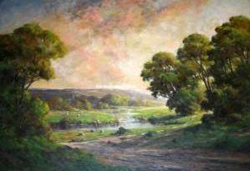
III. Der freie Essay – Zwei Beispiele
Evening over Sussex
(publiziert 1942)
„Evening is kind to Sussex, for Sussex is no longer young, and she is grateful for the veil of evening as an elderly woman is glad when a shade is drawn over a lamp.“
„It is well known how in circumstances like these the self splits up and one self is eager and dissatisfied and the other stern and philosophical”
„gone, gone; over, over; past and done with, past and done with“
Harold Goldthwaite, Evening in Sussex

Slide 11
III. Der freie Essay – Zwei Beispiele
Evening over Sussex (publiziert 1942)
„A self which lies in ambush, apparently dormant, and jumps upon us unawares. It remarks are often entirely disconnected with what has been happening, but must be attended to because of their abruptness”
„Draughts fan-blown by electric power will cleanse houses“
„Now, I said, comes the season of making up accounts. Now we have got to collect ourselves; we have got to be one self”.
„What we have made then today, I said, is this: that beauty; death of individual; and the future“.
„Look, I will make a little figure for your satisfaction; here he comes“
„Eggs and bacon; toast and tea; fire and a bath; fire and a bath; jugged hare […] and then to bed“.
„And the rest of the journey was performed in the delicious society of my own body“.

Slide 12
Der Essay als androgyne Form?
A Room of One‘s Own (1929)
„The human frame being what it is, heart, body, and brain all mixed together, and not contained in separate compartments as they will be no doubt in another million years, a good dinner is of great importance to good talk”
„And since a novel has this correspondence to real life, its values are to some extent those of real life. But it is obvious that the values of women differ very often from the values which have been made by the other sex”
“A scene in a battlefield is more important than a scene in a shop”
„The book has somehow to be adapted to the body, and at a venture one would say that women’s books should be shorter, more concentrated, than those of men, and framed so that they do not need long hours of steady and uninterrupted work. For interruptions there will always be”
„But … I had said ‘but’ too often. One cannot go on saying ‘but’. One must finish the sentence somehow”.

